Slide 1
Optimization Strategy

Slide 2
Objectives
Meaning of denormalization.
When to denormalize to improve performance.

Slide 3
Introduction
Result of normalization is a design that is structurally consistent with minimal redundancy.
However, sometimes a normalized database does not provide maximum processing efficiency.
May be necessary to accept loss of some benefits of a fully normalized design in favor of performance.

Slide 4
Introduction
Also consider that denormalization:
  makes implementation more complex;
  often sacrifices flexibility;
  may speed up retrievals but it slows down updates.

Slide 5
What is Denormalization
Denormalization refers to a refinement to relational schema such that the degree of normalization for a modified relation is less than the degree of at least one of the original relations.
Also use term more loosely to refer to situations where two relations are combined into one new relation, which is still normalized but contains more nulls than original relations.

Slide 6
When to apply denormalization
Consider denormalization in following situations, specifically to speed up frequent or critical transactions:
  Combining 1:1 relationships
  Duplicating non-key attributes in 1:* relationships to reduce joins
  Duplicating foreign key attributes in 1:* relationships to reduce joins
  Introducing repeating groups
  Partitioning relations

Slide 7
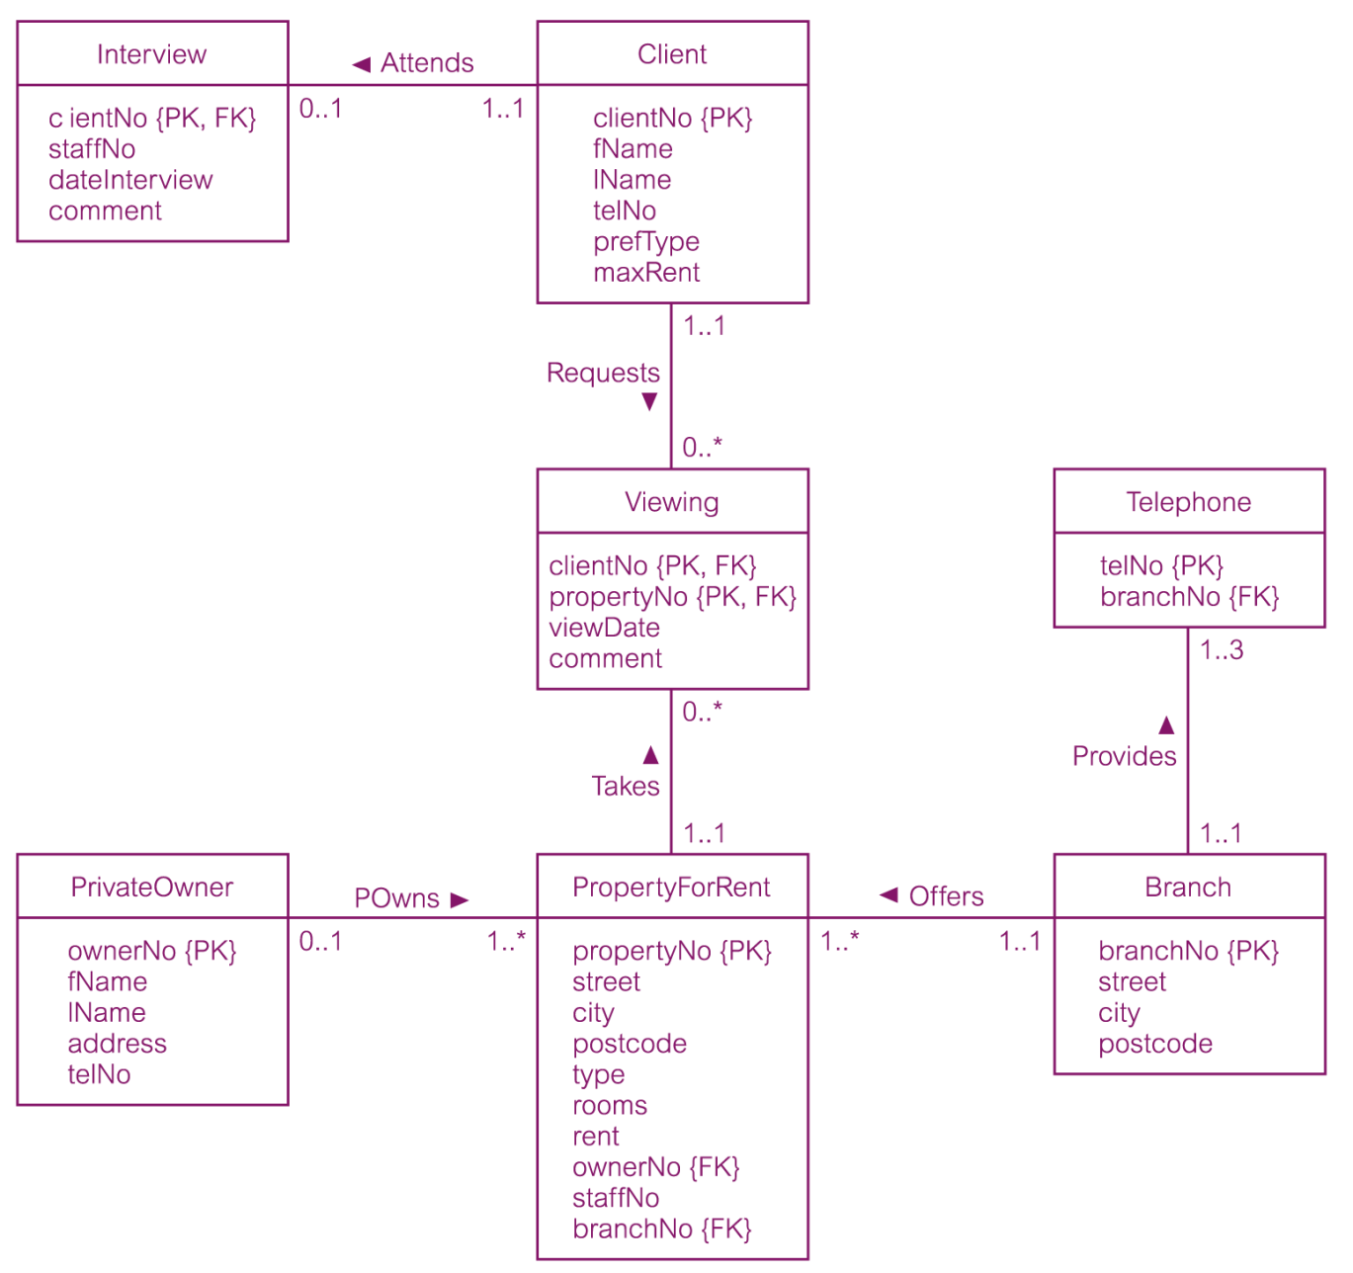
Sample Relation Diagram

Slide 8
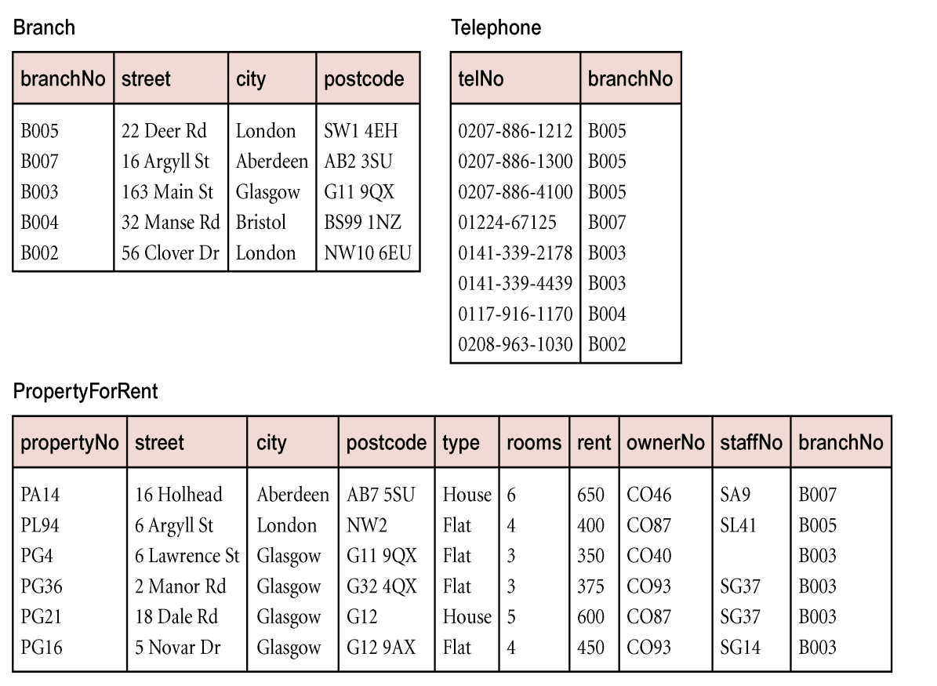
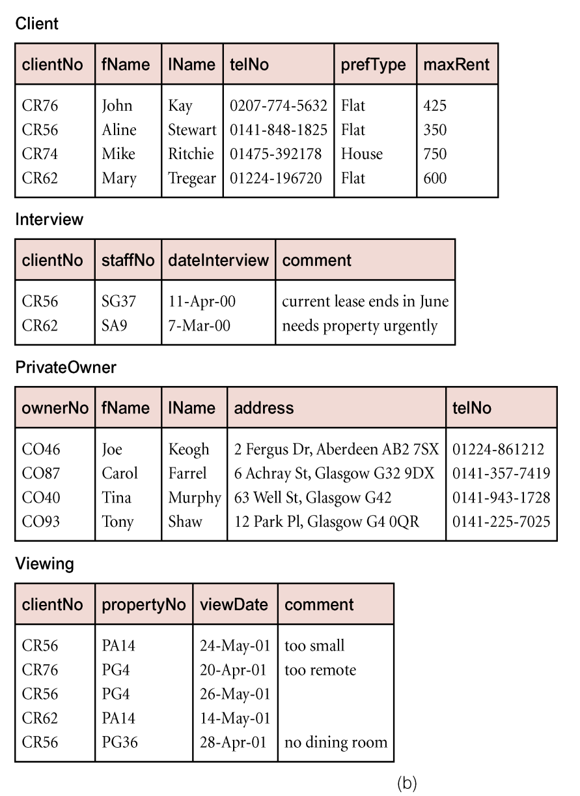
Sample Relations

Slide 9
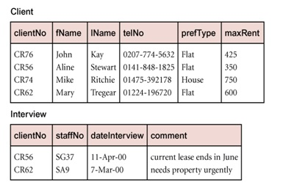
Combining 1:1 relationships

Slide 10
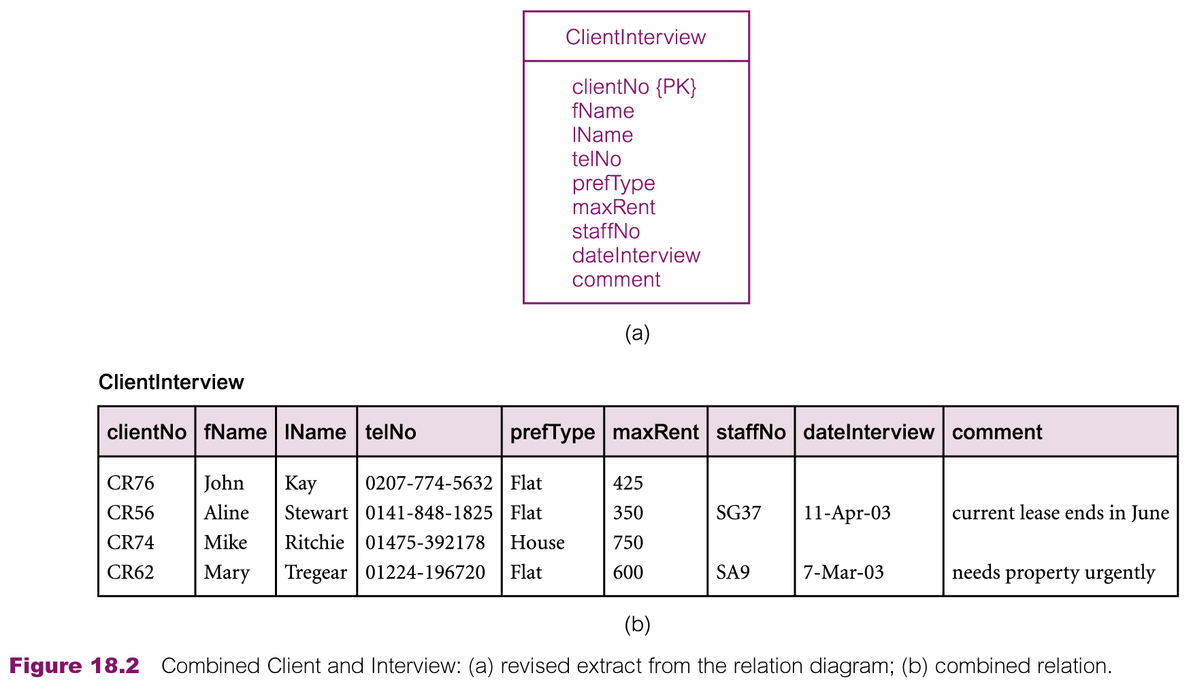
Combining 1:1 relationships

Slide 11
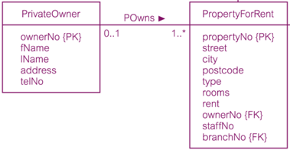
Duplicating non-key attributes in 1:* relationships to reduce joins
SELECT p.*, o.lName
FROM PropertyForRent p, PrivateOwner o
WHERE p.ownerNo = o.ownerNo AND branchNo = ‘B003’;

Slide 12
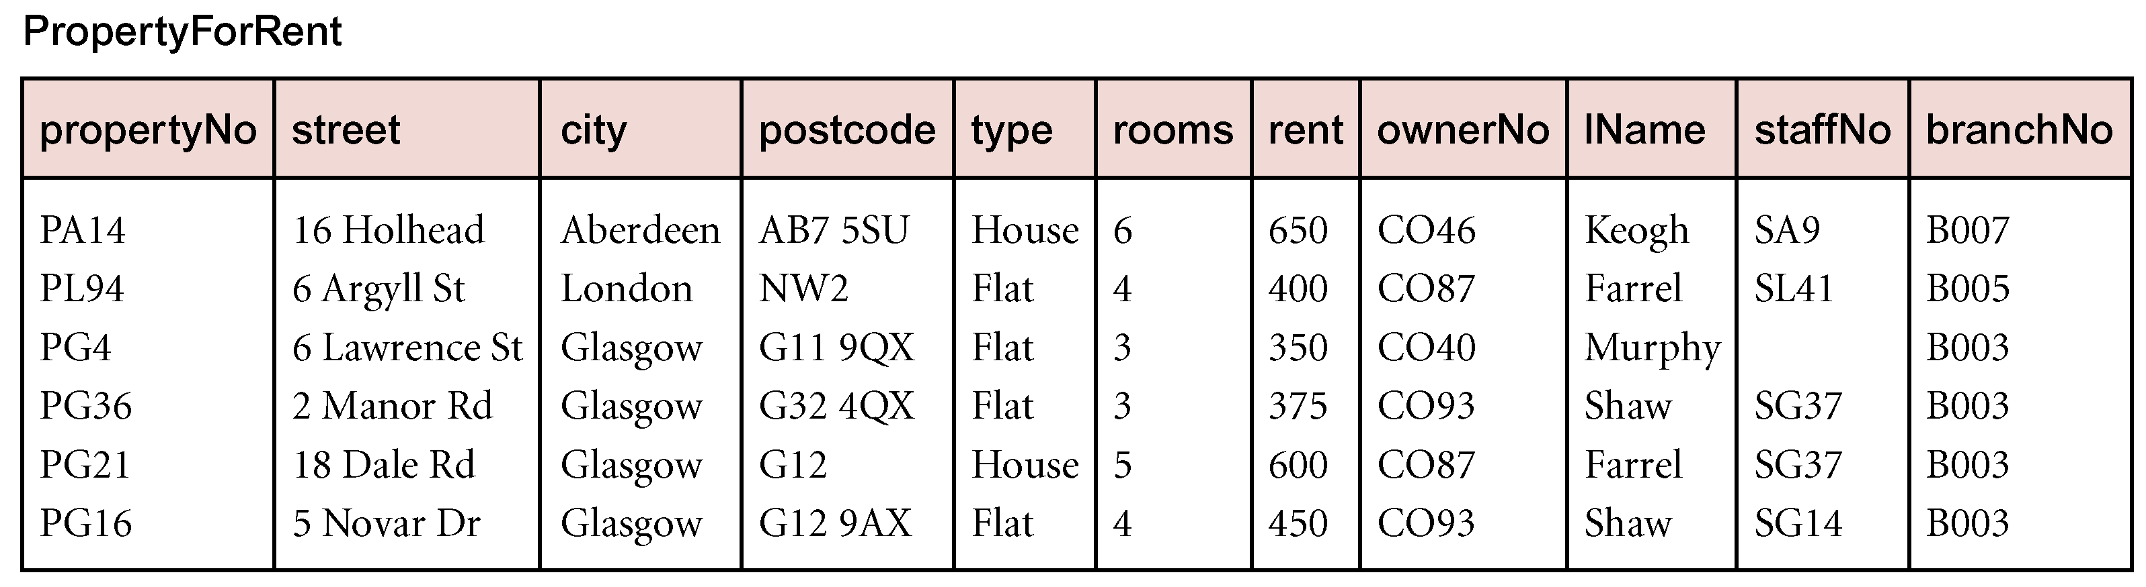
Duplicating non-key attributes in 1:* relationships to reduce joins
SELECT p.*
FROM PropertyForRent p
WHERE branchNo = ‘B003’;
Notes:
Before copying owner Lname
SELECT p.*, o.lName
FROM PropertyForRent p, PrivateOwner o
WHERE p.ownerNo = o.ownerNo AND branchNo = ‘B003’;
based on the original relation diagram and sample relations shown in Figure 18.1. If we
duplicate the lName attribute in the PropertyForRent relation, we can remove the PrivateOwner
relation from the query, which in SQL becomes:
After copying Owner Lname
SELECT p.*
FROM PropertyForRent p
WHERE branchNo = ‘B003’;

Slide 13
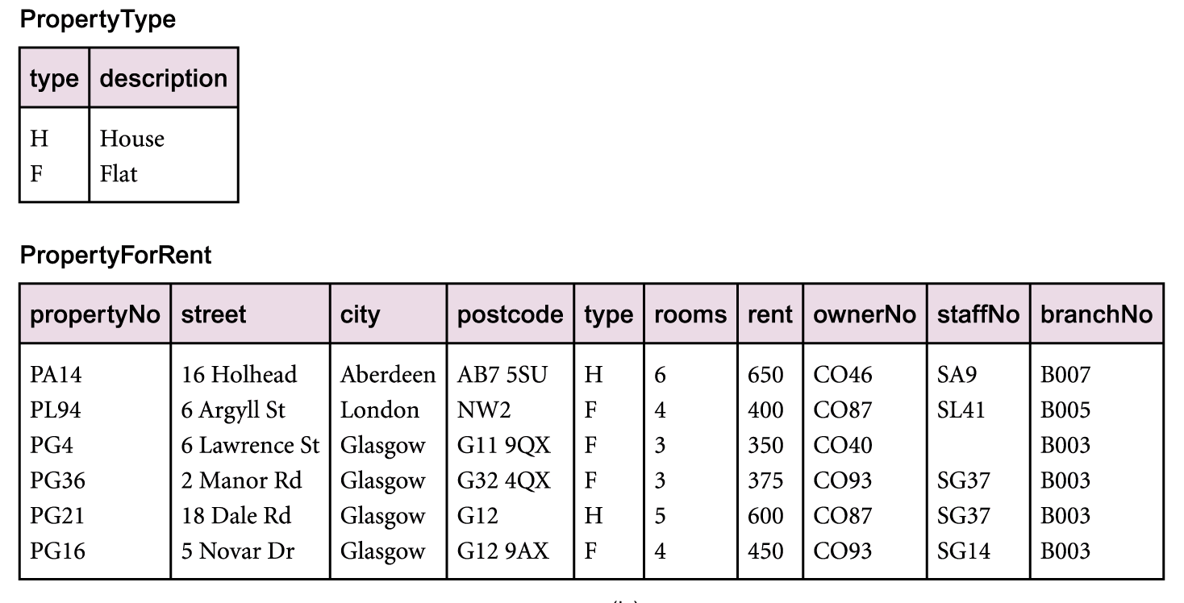
Duplicating non-key attributes in 1:* relationships: Lookup Table

Slide 14
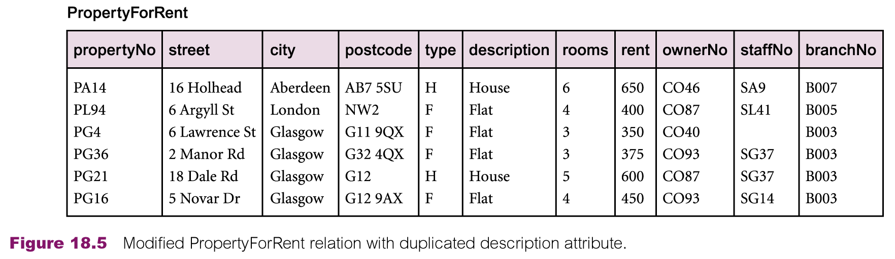
Duplicating non-key attributes in 1:* relationships: Lookup Table

Slide 15
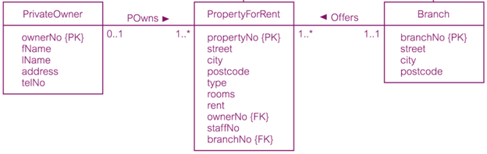
Duplicating FK attributes in 1:* relationship to reduce joins

Slide 16
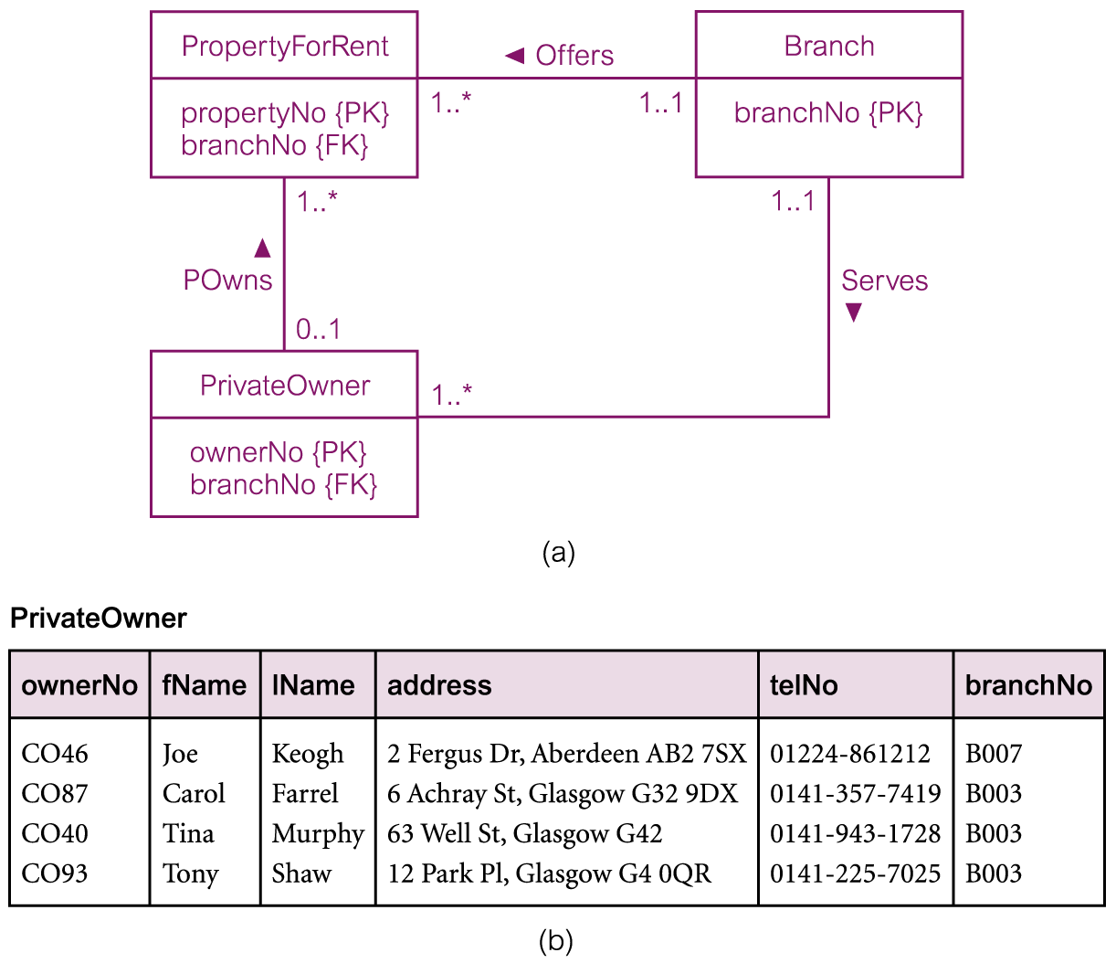
Duplicating FK attributes in 1:* relationship to reduce joins
Notes:
If an owner could rent properties through many branches, the above change would
not work. In this case, it would be necessary to model a many-to-many (*:*) relation-
ship between Branch and PrivateOwner. Note also that the PropertyForRent relation has the
branchNo attribute because it is possible for a property not to have a member of staff allo-
cated to it, particularly at the start when the property is ﬁrst taken on by the agency. If the
PropertyForRent relation did not have the branch number, it would be necessary to join the
PropertyForRent relation to the Staff relation based on the staffNo attribute to get the required
branch number. The original SQL query would then become:
SELECT o.lName
FROM Staff s, PropertyForRent p, PrivateOwner o
WHERE s.staffNo = p.staffNo AND p.ownerNo = o.ownerNo AND s.branchNo = ‘B003’;
Removing two joins from the query may provide greater justiﬁcation for creating a
direct relationship between PrivateOwner and Branch and thereby duplicating the foreign
key branchNo in the PrivateOwner relation.

Slide 17
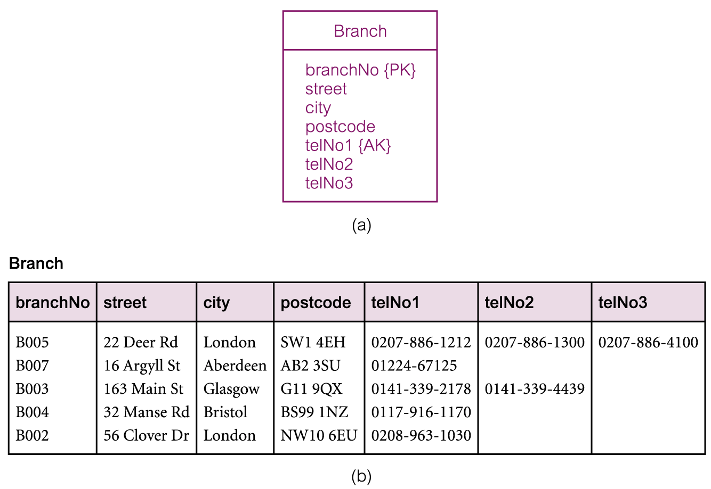
Introducing repeating groups
Notes:
In general, this type of denormalization should be considered only in the following
circumstances:
n the absolute number of items in the repeating group is known (in this example there is
a maximum of three telephone numbers);
n the number is static and will not change over time (the maximum number of telephone
lines is ﬁxed and is not expected to change);
n the number is not very large, typically not greater than 10, although this is not as import-
ant as the ﬁrst two conditions.

Slide 18
Partitioning relations
Rather than combining relations together, alternative approach is to decompose them into a number of smaller and more manageable partitions.
Two main types of partitioning: horizontal and vertical.

Slide 19
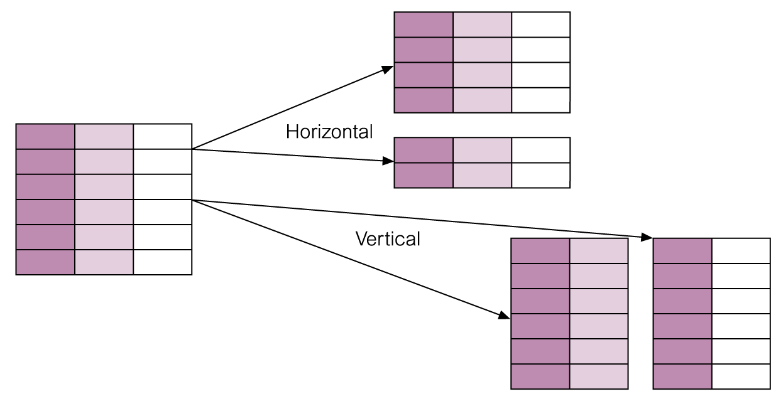
Partitioning relations

Slide 20
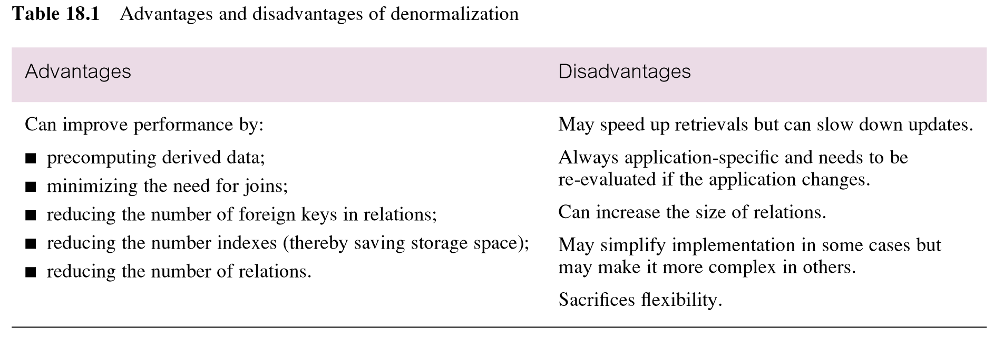
Advantages and disadvantages of denormalization

Slide 21
Q & A

